Slide 1
CISC7204
Data Science and Data Visualization
Day 05, 2026 September 16 07:00 pm – 08:00 pm E4-G078
Introduction to Data Visualization Plots
Lecture 05
Dr. Kam Hou Vat
fstkhv@um.edu.mo
E11-4087 (Ext: 4476)
Office Hours:
Wednesday 12:30 pm – 01:30 pm

Slide 2
Introduction to Data Visualization Plots
CISC7204 Data Science and Data Visualization
Outline To Follow | Units To Enhance Your Learning
Part 1 | Introduction
Part 2 | Comparison Plots
Part 3 | Relation Plots
Part 4 | Composition Plots
Part 5 | Distribution Plots
Part 6 | Geoplots
Part 7 | What Makes a Good Visualization?
Part 8 | Summary

Slide 3
Introduction to Data Visualization Plots
CISC7204 Data Science and Data Visualization
Part 1: Introduction
In the previous lectures, we learned how to work with new datasets and get familiar with their data and structure. We also got hands-on experience of how to analyze and transform them using different data wrangling techniques such as filtering, sorting, and reshaping. All of these techniques will come in handy when working with further real-world datasets in the coming activities.
In this lecture, we will focus on various visualizations and identify which visualization is best for showing certain information for a given dataset. We will describe every visualization in detail and give practical examples, such as comparing different stocks over time or comparing the ratings for different movies.
Starting with comparison plots, which are great for comparing multiple variables over time, we will look at their types (such as line charts, bar charts, and radar charts). We will then move onto relation plots, which are handy for showing relationships among variables. We will cover scatter plots for showing the relationship between two variables, bubble plots for three variables, correlograms for variable pairs, and finally, heatmaps for visualizing multivariate data.
Next, we will will further explain composition plots (used to visualize variables that are part of a whole), as well as pie charts, stacked bar charts, stacked area charts, and Venn diagrams. To give you a deeper insight into the distribution of variables, we will discuss distribution plots, describing histograms, density plots, box plots, and violin plots..
Finally, we will talk about dot maps, connection maps, and choropleth maps, which can be categorized into geoplots. Geoplots are useful for visualizing geospatial data.

Slide 4
Introduction to Data Visualization Plots
CISC7204 Data Science and Data Visualization
Part 2: Comparison Plots
Comparison plots include charts that are ideal for comparing multiple variables or variables over time.
Line charts are great for visualizing variables over time.
For comparison among items, bar charts (also called column charts) are the best way to go. For a certain time period (say, fewer than 10-time points), vertical bar charts can be used as well.
Radar charts or spider plots are great for visualizing multiple variables for multiple groups.

Slide 5
Introduction to Data Visualization Plots
CISC7204 Data Science and Data Visualization
Part 2: Comparison Plots
Line Chart
Line charts are used to display quantitative values over a continuous time period and show information as a series. A line chart is ideal for a time series that is connected by straight-line segments.
The value being measured is placed on the y-axis, while the x-axis is the timescale.

Slide 6
Introduction to Data Visualization Plots
CISC7204 Data Science and Data Visualization
Part 2: Comparison Plots
Line Chart - Uses
Line charts are great for comparing multiple variables and visualizing trends for both single as well as multiple variables, especially if your dataset has many time periods (more than 10).
For smaller time periods, vertical bar charts might be the better choice.

Slide 7
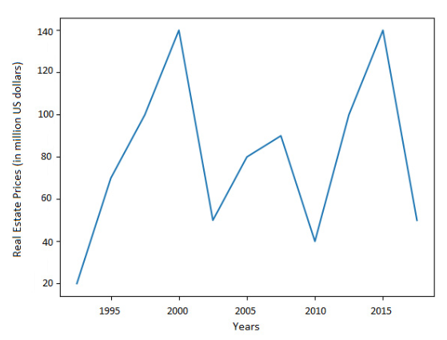
Introduction to Data Visualization Plots
CISC7204 Data Science and Data Visualization
Part 2: Comparison Plots
Line Chart
Example
The diagram shows a trend of real estate prices (per million US dollars) across two decades. Line charts are ideal for showing data trends.

Slide 8
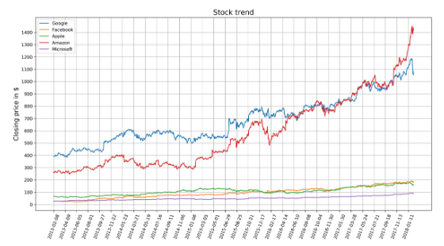
Introduction to Data Visualization Plots
CISC7204 Data Science and Data Visualization
Part 2: Comparison Plots
Line Chart
Example
The figure is a multiple-variable line chart that compares the stock-closing prices for Google, Facebook, Apple, Amazon, and Microsoft.
A line chart is great for comparing values and visualizing the trend of the stock. As we can see, Amazon shows the highest growth:
Line chart showing stock trends for five companies

Slide 9
Introduction to Data Visualization Plots
CISC7204 Data Science and Data Visualization
Part 2: Comparison Plots
Line Chart – Design Practices
Avoid too many lines per chart.
Adjust your scale so that the trend is clearly visible.
Note
For plots with multiple variables, a legend should be given to describe each variable.

Slide 10
Introduction to Data Visualization Plots
CISC7204 Data Science and Data Visualization
Part 2: Comparison Plots
Bar Chart
In a bar chart, the bar length encodes the value. There are two variants of bar charts: vertical bar charts and horizontal bar charts.
Use
While they are both used to compare numerical values across categories, vertical bar charts are sometimes used to show a single variable over time.

Slide 11
Introduction to Data Visualization Plots
CISC7204 Data Science and Data Visualization
Part 2: Comparison Plots
Bar Chart
Don’ts of Bar Charts
  Don’t confuse vertical bar charts with histograms. Bar charts compare different variables or categories, while histograms show the distribution for a single variable.
  Another common mistake is to use bar charts to show central tendencies among groups or categories. Use box plots or violin plots to show statistical measures or distributions in these cases.

Slide 12
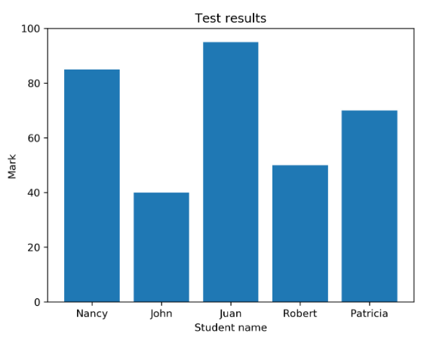
Introduction to Data Visualization Plots
CISC7204 Data Science and Data Visualization
Part 2: Comparison Plots
Bar Chart
Example
The diagram shows a vertical bar chart. Each bar shows the marks out of 100 that 5 students obtained in a test:
Vertical bar chart using student test data

Slide 13
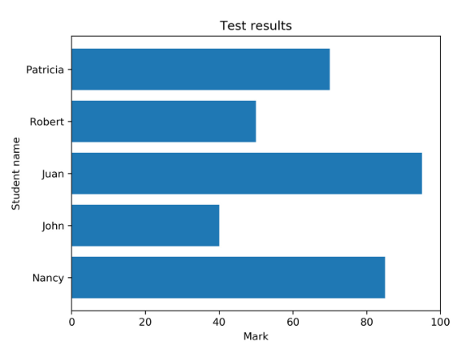
Introduction to Data Visualization Plots
CISC7204 Data Science and Data Visualization
Part 2: Comparison Plots
Bar Chart
Example
The diagram shows a horizontal bar chart. Each bar shows the marks out of 100 that 5 students obtained in a test:
Horizontall bar chart using student test data

Slide 14
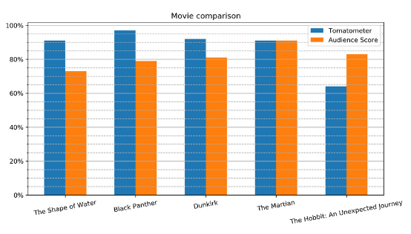
Introduction to Data Visualization Plots
CISC7204 Data Science and Data Visualization
Part 2: Comparison Plots
Bar Chart
Example
The following diagram compares movie ratings, giving two different scores.
The Tomatometer is the percentage of approved critics who have given a positive review for the movie.
The Audience Score is the percentage of users who have given a score of 3.5 or higher out of 5. As we can see,
The Martian is the only movie with both a high Tomatometer and Audience Score.
The Hobbit: An Unexpected Journey has a relatively high Audience Score compared to the Tomatometer score, which might be due to a huge fan base:
Comparative bar chart

Slide 15
Introduction to Data Visualization Plots
CISC7204 Data Science and Data Visualization
Part 2: Comparison Plots
Bar Chart – Design Practices
The axis corresponding to the numerical variable should start at zero. Starting with another value might be misleading, as it makes a small value difference look like a big one.
Use horizontal labels—that is, as long as the number of bars is small, and the chart doesn’t look too cluttered.
The labels can be rotated to different angles if there isn’t enough space to present them horizontally. You can see this on the labels of the x-axis of the preceding diagram.

Slide 16
Introduction to Data Visualization Plots
CISC7204 Data Science and Data Visualization
Part 2: Comparison Plots
Radar Chart
Radar charts (also known as spider or web charts) visualize multiple variables with each variable plotted on its own axis, resulting in a polygon. All axes are arranged radially, starting at the center with equal distances between one another, and have the same scale.
Uses
Radar charts are great for comparing multiple quantitative variables for a single group or multiple groups.
They are also useful for showing which variables score high or low within a dataset, making them ideal for visualizing performance.

Slide 17
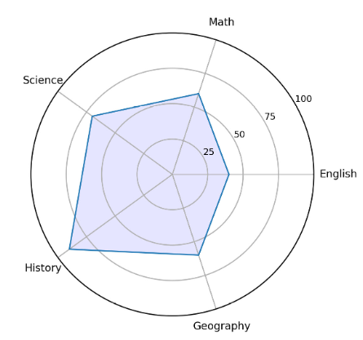
Introduction to Data Visualization Plots
CISC7204 Data Science and Data Visualization
Part 2: Comparison Plots
Radar Chart
Example
The diagram shows a radar chart for a single variable. This chart displays data about a student scoring marks in different subjects:
Radar chart for one variable (student)

Slide 18
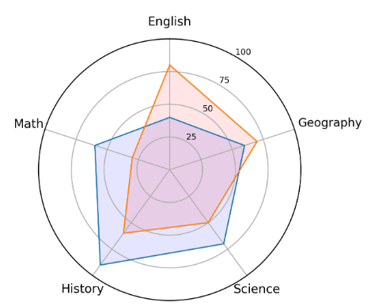
Introduction to Data Visualization Plots
CISC7204 Data Science and Data Visualization
Part 2: Comparison Plots
Radar Chart
Example
The diagram shows a radar chart for two variables/groups. Here, the chart explains the marks that were scored by two students in different subjects:
Radar chart for two variables (two students)

Slide 19
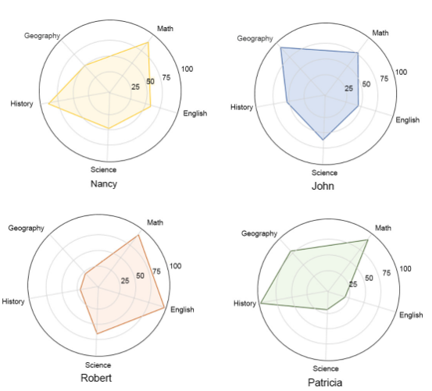
Introduction to Data Visualization Plots
CISC7204 Data Science and Data Visualization
Part 2: Comparison Plots
Radar Chart
Example
The following diagram shows a radar chart for multiple variables/groups. Each chart displays data about a student’s performance in different subjects:
Radar chart with faceting for multiple variables (multiple students)

Slide 20
Introduction to Data Visualization Plots
CISC7204 Data Science and Data Visualization
Part 2: Comparison Plots
Radar Chart – Design Practices
Try to display 10 factors or fewer on a single radar chart to make it easier to read.
Use faceting (displaying each variable in a separate plot) for multiple variables/groups, as shown in the preceding diagram, in order to maintain clarity.

Slide 21
Introduction to Data Visualization Plots
CISC7204 Data Science and Data Visualization
Part 2: Comparison Plots
Sum Up
In this section, we learned which plots are suitable for comparing items.
Line charts are great for comparing something over time, whereas bar charts are for comparing different items.
Last but not least, radar charts are best suited for visualizing multiple variables for multiple groups.

Slide 22
Introduction to Data Visualization Plots
CISC7204 Data Science and Data Visualization
Part 3: Relation Plots
Relation plots are perfectly suited to showing relationships among variables.
A scatter plot visualizes the correlation between two variables for one or multiple groups.
Bubble plots can be used to show relationships between three variables. The additional third variable is represented by the dot size.
Heatmaps are great for revealing patterns or correlations between two qualitative variables.
A correlogram is a perfect visualization for showing the correlation among multiple variables.

Slide 23
Introduction to Data Visualization Plots
CISC7204 Data Science and Data Visualization
Part 3: Relation Plots
Scatter Plot
Scatter plots show data points for two numerical variables, displaying a variable on both axes.
Uses
You can detect whether a correlation (relationship) exists between two variables.
They allow you to plot the relationship between multiple groups or categories using different colors.
A bubble plot, which is a variation of the scatter plot, is an excellent tool for visualizing the correlation of a third variable.

Slide 24
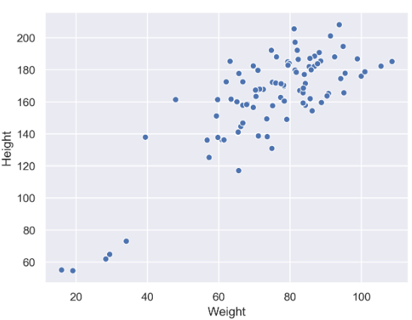
Introduction to Data Visualization Plots
CISC7204 Data Science and Data Visualization
Part 3: Relation Plots
Scatter Plot
Example
The diagram shows a scatter plot of height and weight of persons belonging to a single group:
Scatter plot with a single group

Slide 25
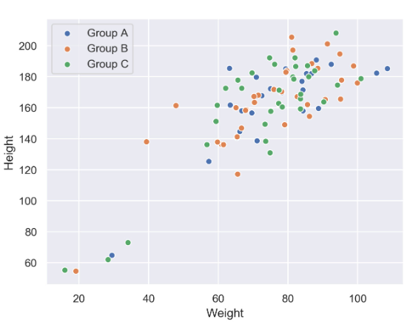
Introduction to Data Visualization Plots
CISC7204 Data Science and Data Visualization
Part 3: Relation Plots
Scatter Plot
Example
The diagram shows the same data as in the previous plot but differentiates between groups.
In this case, we have different groups: A, B, and C:
Scatter plot with multiple groups

Slide 26
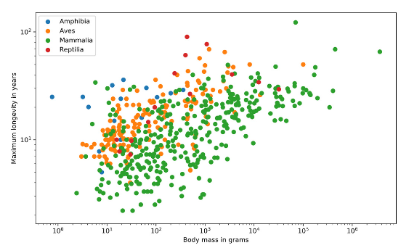
Introduction to Data Visualization Plots
CISC7204 Data Science and Data Visualization
Part 3: Relation Plots
Scatter Plot
Example
The diagram shows the correlation between body mass and the maximum longevity for various animals grouped by their classes.
There is a positive correlation between body mass and maximum longevity:
Correlation between body mass and maximum longevity for animals

Slide 27
Introduction to Data Visualization Plots
CISC7204 Data Science and Data Visualization
Part 3: Relation Plots
Scatter Plot – Design Practices
Start both axes at zero to represent data accurately.
Use contrasting colors for data points and avoid using symbols for scatter plots with multiple groups or categories.

Slide 28
Introduction to Data Visualization Plots
CISC7204 Data Science and Data Visualization
Part 3: Relation Plots
Scatter Plot – Variants
Scatter Plots with Marginal Histograms
In addition to the scatter plot, which visualizes the correlation between two numerical variables, you can plot the marginal distribution for each variable in the form of histograms to give better insight into how each variable is distributed.

Slide 29
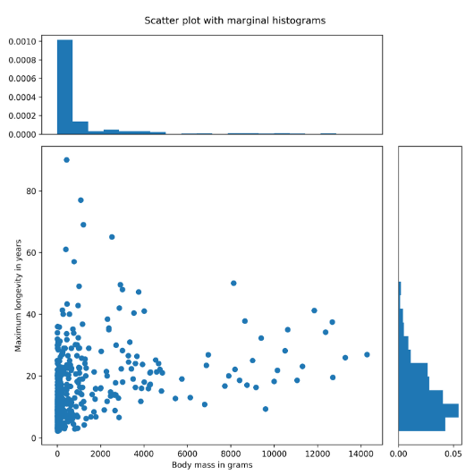
Introduction to Data Visualization Plots
CISC7204 Data Science and Data Visualization
Part 3: Relation Plots
Scatter Plots with Marginal Histograms
Example
The diagram shows the correlation between body mass and the maximum longevity for animals in the Aves class.
The marginal histograms are also shown, which helps to get a better insight into both variables:
Correlation between body mass and maximum longevity of the Aves class with marginal histograms

Slide 30
Introduction to Data Visualization Plots
CISC7204 Data Science and Data Visualization
Part 3: Relation Plots
Bubble Plot
A bubble plot extends a scatter plot by introducing a third numerical variable. The value of the variable is represented by the size of the dots. The area of the dots is proportional to the value. A legend is used to link the size of the dot to an actual numerical value.
Use
Bubble plots help to show a correlation between three variables.

Slide 31
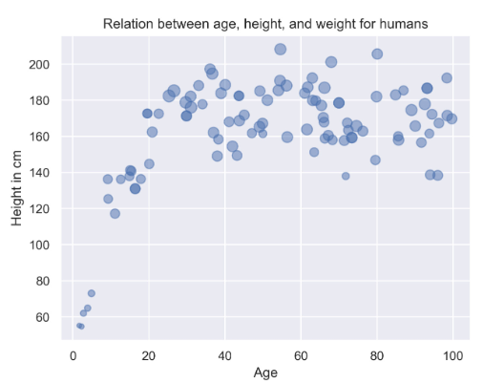
Introduction to Data Visualization Plots
CISC7204 Data Science and Data Visualization
Part 3: Relation Plots
Bubble Plots
Example
The following diagram shows a bubble plot that highlights the relationship between heights and age of humans to get the weight of each person, which is represented by the size of the bubble:
Bubble plot showing the relation between height and age of humans

Slide 32
Introduction to Data Visualization Plots
CISC7204 Data Science and Data Visualization
Part 3: Relation Plots
Bubble Plot – Design Practices
The design practices for the scatter plot are also applicable to the bubble plot.
Don’t use bubble plots for very large amounts of data, since too many bubbles make the chart difficult to read.

Slide 33
Introduction to Data Visualization Plots
CISC7204 Data Science and Data Visualization
Part 3: Relation Plots
Correlogram
A correlogram is a combination of scatter plots and histograms. Histograms will be discussed in detail later in this lecture. A correlogram or correlation matrix visualizes the relationship between each pair of numerical variables using a scatter plot.
The diagonals of the correlation matrix represent the distribution of each variable in the form of a histogram. You can also plot the relationship between multiple groups or categories using different colors. A correlogram is a great chart for exploratory data analysis to get a feel for your data, especially the correlation between variable pairs.

Slide 34
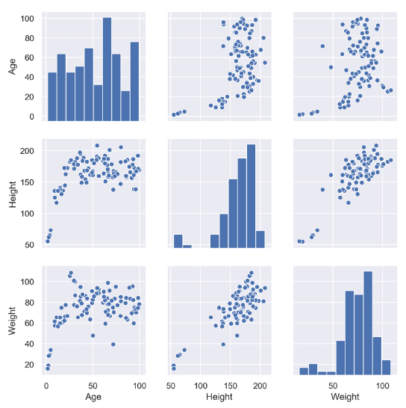
Introduction to Data Visualization Plots
CISC7204 Data Science and Data Visualization
Part 3: Relation Plots
Correlogram
Example
The diagram shows a correlogram for the height, weight, and age of humans.
The diagonal plots show a histogram for each variable.
The off-diagonal elements show scatter plots between variable pairs:
Correlogram with a single category

Slide 35
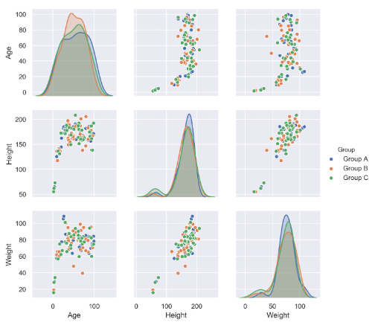
Introduction to Data Visualization Plots
CISC7204 Data Science and Data Visualization
Part 3: Relation Plots
Correlogram
Example
The following diagram shows the correlogram with data samples separated by color into different groups:
Correlogram with multiple categories

Slide 36
Introduction to Data Visualization Plots
CISC7204 Data Science and Data Visualization
Part 3: Relation Plots
Correlogram – Design Practices
Start both axes at zero to represent data accurately.
Use contrasting colors for data points and avoid using symbols for scatter plots with multiple groups or categories.

Slide 37
Introduction to Data Visualization Plots
CISC7204 Data Science and Data Visualization
Part 3: Relation Plots
Heatmap
A heatmap is a visualization where values contained in a matrix are represented as colors or color saturation. Heatmaps are great for visualizing multivariate data (data in which analysis is based on more than two variables per observation), where categorical variables are placed in the rows and columns and a numerical or categorical variable is represented as colors or color saturation.
Use
The visualization of multivariate data can be done using heatmaps as they are great for finding patterns in your data.

Slide 38
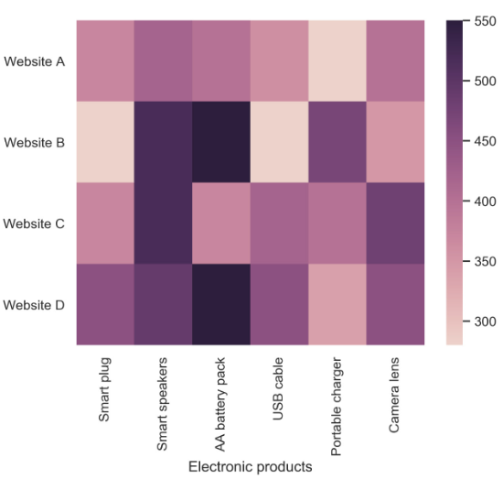
Introduction to Data Visualization Plots
CISC7204 Data Science and Data Visualization
Part 3: Relation Plots
Heatmap
Example
The following diagram shows a heatmap for the most popular products on the electronics category page across various e-commerce websites, where the color shows the number of units sold.
In the following diagram, we can analyze that the darker colors represent more units sold, as shown in the key:
Heatmap for popular products in the electronics category

Slide 39
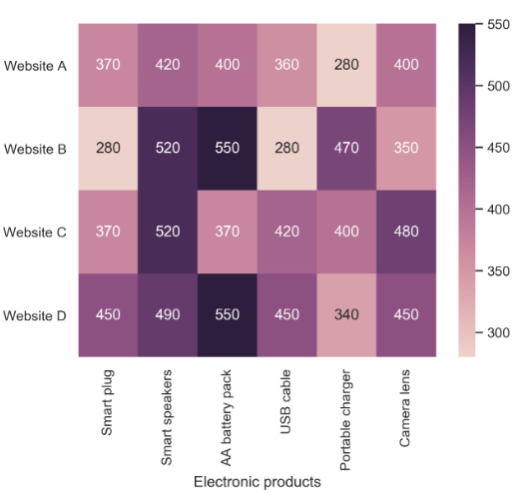
Introduction to Data Visualization Plots
CISC7204 Data Science and Data Visualization
Part 3: Relation Plots
Variants: Annotated Heatmap
Example
Let’s see the same example we saw previously in an annotated heatmap, where the color shows the number of units sold:
Annotated heatmap for popular products in the electronics category

Slide 40
Introduction to Data Visualization Plots
CISC7204 Data Science and Data Visualization
Part 3: Relation Plots
Heatmap – Design Practices
Select colors and contrasts that will be easily visible to individuals with vision problems so that your plots are more inclusive.

Slide 41
Introduction to Data Visualization Plots
CISC7204 Data Science and Data Visualization
Part 3: Relation Plots
Sum Up
In this section, we introduced various plots for relating a variable to other variables and looked at their uses, and multiple examples for the different relation plots were given.

Slide 42
Introduction to Data Visualization Plots
CISC7204 Data Science and Data Visualization
Part 4: Composition Plots
Composition plots are ideal if you think about something as a part of a whole. For static data, you can use pie charts, stacked bar charts, or Venn diagrams.
Pie charts or donut charts help show proportions and percentages for groups.
If you need an additional dimension, stacked bar charts are great. Venn diagrams are the best way to visualize overlapping groups, where each group is represented by a circle.
For data that changes over time, you can use either stacked bar charts or stacked area charts.

Slide 43
Introduction to Data Visualization Plots
CISC7204 Data Science and Data Visualization
Part 4: Composition Plots
Pie Chart
Pie charts illustrate numerical proportions by dividing a circle into slices. Each arc length represents a proportion of a category. The full circle equates to 100%. For humans, it is easier to compare bars than arc lengths; therefore, it is recommended to use bar charts or stacked bar charts the majority of the time.
Use
To compare items that are part of a whole.

Slide 44
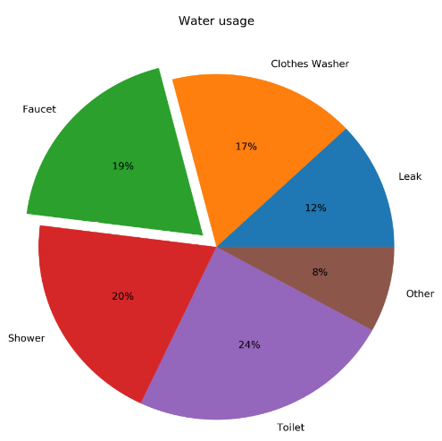
Introduction to Data Visualization Plots
CISC7204 Data Science and Data Visualization
Part 4: Composition Plots
Pie Chart
Example
The following diagram shows household water usage around the world:
Pie chart for global household water usage

Slide 45
Introduction to Data Visualization Plots
CISC7204 Data Science and Data Visualization
Part 4: Composition Plots
Pie Chart – Design Practices
Arrange the slices according to their size in increasing/decreasing order, either in a clockwise or counterclockwise manner.
Make sure that every slice has a different color.

Slide 46
Introduction to Data Visualization Plots
CISC7204 Data Science and Data Visualization
Part 4: Composition Plots
Variants: Donut Chart
An alternative to a pie chart is a donut chart. In contrast to pie charts, it is easier to compare the size of slices, since the reader focuses more on reading the length of the arcs instead of the area.
Donut charts are also more space-efficient because the center is cut out, so it can be used to display information or further divide groups into subgroups.

Slide 47
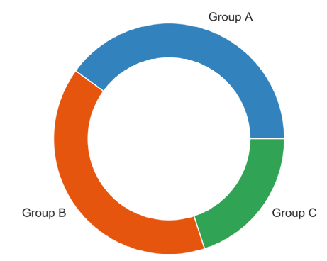
Introduction to Data Visualization Plots
CISC7204 Data Science and Data Visualization
Part 4: Composition Plots
Donut Chart
Example
The diagram shows a basic donut chart:
Donut chart

Slide 48
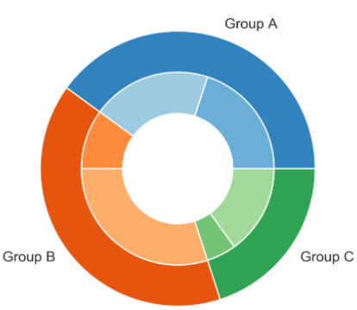
Introduction to Data Visualization Plots
CISC7204 Data Science and Data Visualization
Part 4: Composition Plots
Donut Chart
Example
The diagram shows a donut chart with subgroups:
Donut chart with subgroups

Slide 49
Introduction to Data Visualization Plots
CISC7204 Data Science and Data Visualization
Part 4: Composition Plots
Variants: Donut Chart – Design Practices
Use the same color that’s used for the category for the subcategories. Use varying brightness levels for the different subcategories.

Slide 50
Introduction to Data Visualization Plots
CISC7204 Data Science and Data Visualization
Part 4: Composition Plots
Stacked Bar Chart
Stacked bar charts are used to show how a category is divided into subcategories and the proportion of the subcategory in comparison to the overall category. You can either compare total amounts across each bar or show a percentage of each group. The latter is also referred to as a 100% stacked bar chart and makes it easier to see relative differences between quantities in each group.
Use
To compare variables that can be divided into sub-variables

Slide 51
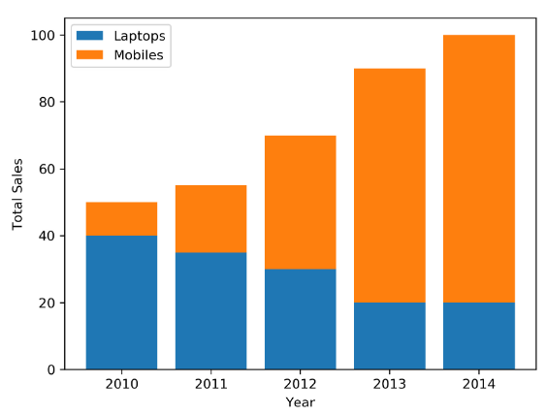
Introduction to Data Visualization Plots
CISC7204 Data Science and Data Visualization
Part 4: Composition Plots
Stacked Bar Chart
Example
The diagram shows a generic stacked bar chart with five groups:
Stacked bar chart to show sales of laptops and mobiles

Slide 52
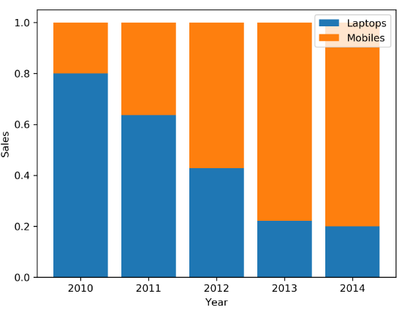
Introduction to Data Visualization Plots
CISC7204 Data Science and Data Visualization
Part 4: Composition Plots
Stacked Bar Chart
Example
The diagram shows a 100% stacked bar chart with the same data that was used in the preceding diagram:
100% stacked bar chart to show sales of laptops, PCs, and mobiles

Slide 53
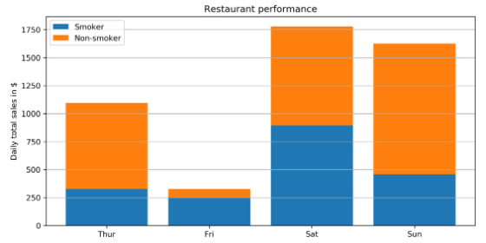
Introduction to Data Visualization Plots
CISC7204 Data Science and Data Visualization
Part 4: Composition Plots
Stacked Bar Chart
Example
The diagram illustrates the daily total sales of a restaurant over several days.
The daily total sales of non-smokers are stacked on top of the daily total sales of smokers:
Daily total restaurant sales categorized by smokers and non-smokers

Slide 54
Introduction to Data Visualization Plots
CISC7204 Data Science and Data Visualization
Part 4: Composition Plots
Stacked Bar Chart – Design Practices
Use contrasting colors for stacked bars.
Ensure that the bars are adequately spaced to eliminate visual clutter. The ideal space guideline between each bar is half the width of a bar.
Categorize data alphabetically, sequentially, or by value, to uniformly order it and make things easier for your audience.

Slide 55
Introduction to Data Visualization Plots
CISC7204 Data Science and Data Visualization
Part 4: Composition Plots
Stacked Area Chart
Stacked area charts show trends for part-of-a-whole relations. The values of several groups are illustrated by stacking individual area charts on top of one another. It helps to analyze both individual and overall trend information.
Use
To show trends for time series that are part of a whole.

Slide 56
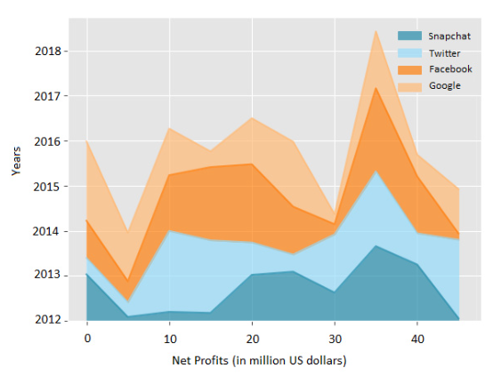
Introduction to Data Visualization Plots
CISC7204 Data Science and Data Visualization
Part 4: Composition Plots
Stacked Area Chart
Example
The following diagram shows a stacked area chart with the net profits of Google, Facebook, Twitter, and Snapchat over a decade:
Stacked area chart to show net profits of four companies

Slide 57
Introduction to Data Visualization Plots
CISC7204 Data Science and Data Visualization
Part 4: Composition Plots
Stacked Area Chart – Design Practice
Use transparent colors to improve information visibility. This will help you to analyze the overlapping data and you will also be able to see the grid lines.

Slide 58
Introduction to Data Visualization Plots
CISC7204 Data Science and Data Visualization
Part 4: Composition Plots
Venn Diagram
Venn diagrams, also known as set diagrams, show all possible logical relations between a finite collection of different sets.
Each set is represented by a circle.
The circle size illustrates the importance of a group.
The size of overlap represents the intersection between multiple groups.
Use
To show overlaps for different sets

Slide 59
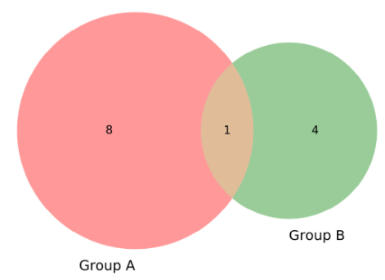
Introduction to Data Visualization Plots
CISC7204 Data Science and Data Visualization
Part 4: Composition Plots
Venn Diagram
Example
Visualizing the intersection of the following diagram shows a Venn diagram for students in two groups taking the same class in a semester:
Venn diagram showing students taking the same class
From the preceding diagram, we can note that there are eight students in just group A, four students in just group B, and one student in both groups.

Slide 60
Introduction to Data Visualization Plots
CISC7204 Data Science and Data Visualization
Part 4: Composition Plots
Venn Diagram – Design Practice
It is not recommended to use Venn diagrams if you have more than three groups. It would become difficult to understand.

Slide 61
Introduction to Data Visualization Plots
CISC7204 Data Science and Data Visualization
Part 5: Distribution Plots
Distribution plots give a deep insight into how your data is distributed.
For a single variable, a histogram is effective.
For multiple variables, you can either use a box plot or a violin plot. The violin plot visualizes the densities of your variables, whereas the box plot just visualizes the median, the interquartile range, and the range for each variable.

Slide 62
Introduction to Data Visualization Plots
CISC7204 Data Science and Data Visualization
Part 5: Distribution Plots
Histogram
A histogram visualizes the distribution of a single numerical variable. Each bar represents the frequency for a certain interval.
Histograms help get an estimate of statistical measures. You see where values are concentrated, and you can easily detect outliers.
You can either plot a histogram with absolute frequency values or, alternatively, normalize your histogram. If you want to compare distributions of multiple variables, you can use different colors for the bars.
Use
Get insights into the underlying distribution for a dataset.

Slide 63
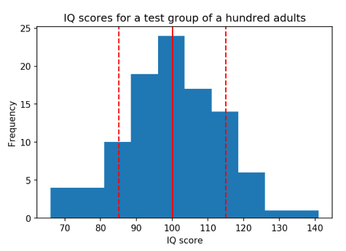
Introduction to Data Visualization Plots
CISC7204 Data Science and Data Visualization
Part 5: Distribution Plots
Histogram
Example
The diagram shows the distribution of the Intelligence Quotient (IQ) for a test group.
The dashed lines represent the standard deviation each side of the mean (the solid line):
Distribution of IQ for a test group of a hundred adults

Slide 64
Introduction to Data Visualization Plots
CISC7204 Data Science and Data Visualization
Part 5: Distribution Plots
Histogram – Design Practice
Try different numbers of bins (data intervals), since the shape of the histogram can vary significantly..

Slide 65
Introduction to Data Visualization Plots
CISC7204 Data Science and Data Visualization
Part 5: Distribution Plots
Density Plot
A density plot shows the distribution of a numerical variable. It is a variation of a histogram that uses kernel smoothing, allowing for smoother distributions. One advantage these have over histograms is that density plots are better at determining the distribution shape since the distribution shape for histograms heavily depends on the number of bins (data intervals).
Use
To compare the distribution of several variables by plotting the density on the same axis and using different colors.

Slide 66
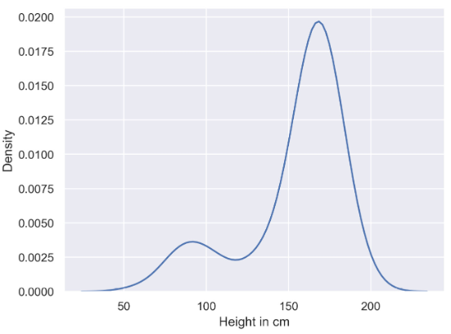
Introduction to Data Visualization Plots
CISC7204 Data Science and Data Visualization
Part 5: Distribution Plots
Density Plot
Example
The diagram shows a basic density plot:
Density plot

Slide 67
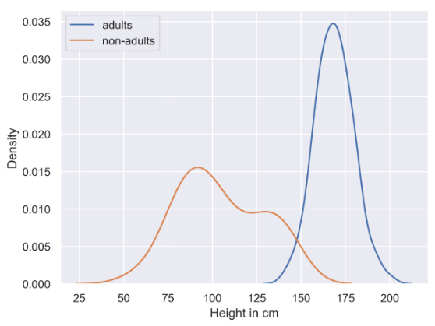
Introduction to Data Visualization Plots
CISC7204 Data Science and Data Visualization
Part 5: Distribution Plots
Density Plot
Example
The diagram shows a basic multi-density plot:
Multi-density plot

Slide 68
Introduction to Data Visualization Plots
CISC7204 Data Science and Data Visualization
Part 5: Distribution Plots
Density Plot – Design Practice
Use contrasting colors to plot the density of multiple variables.

Slide 69
Introduction to Data Visualization Plots
CISC7204 Data Science and Data Visualization
Part 5: Distribution Plots
Box Plot
The box plot shows multiple statistical measurements. The box extends from the lower to the upper quartile values of the data, thus allowing us to visualize the interquartile range (IQR). The horizontal line within the box denotes the median. The parallel extending lines from the boxes are called whiskers; they indicate the variability outside the lower and upper quartiles. There is also an option to show data outliers, usually as circles or diamonds, past the end of the whiskers.
Use
Compare statistical measures for multiple variables or groups.

Slide 70
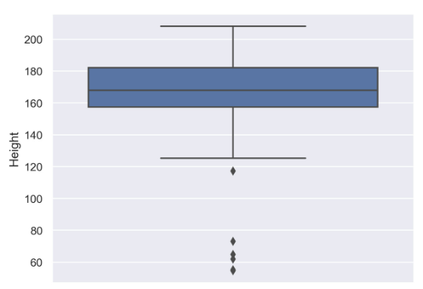
Introduction to Data Visualization Plots
CISC7204 Data Science and Data Visualization
Part 5: Distribution Plots
Box Plot
Example
The diagram shows a basic box plot that shows the height of a group of people:
Box plot showing a single variable

Slide 71
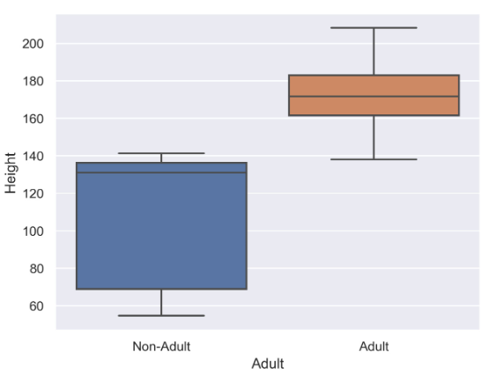
Introduction to Data Visualization Plots
CISC7204 Data Science and Data Visualization
Part 5: Distribution Plots
Box Plot
Example
The diagram shows a basic box plot for multiple variables.
In this case, it shows heights for two different groups – adults and non-adults:
Box plot for multiple variables

Slide 72
Introduction to Data Visualization Plots
CISC7204 Data Science and Data Visualization
Part 5: Distribution Plots
Violin Plot
Violin plots are a combination of box plots and density plots. Both the statistical measures and the distribution are visualized. The thick black bar in the center represents the interquartile range, while the thin black line corresponds to the whiskers in a box plot. The white dot indicates the median. On both sides of the centerline, the density is visualized.
Use
Compare statistical measures and density for multiple variables or groups.

Slide 73
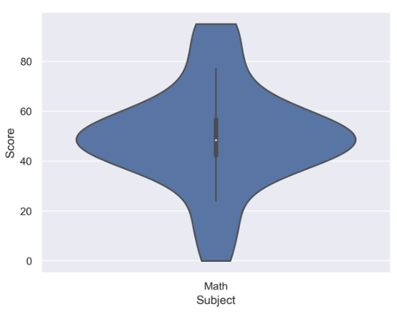
Introduction to Data Visualization Plots
CISC7204 Data Science and Data Visualization
Part 5: Distribution Plots
Violin Plot
Example
The following diagram shows a violin plot for a single variable and shows how students have performed in Math:
Violin plot for a single variable (Math)
From the diagram, we can analyze that most of the students have scored around 40-60 in the Math test.

Slide 74
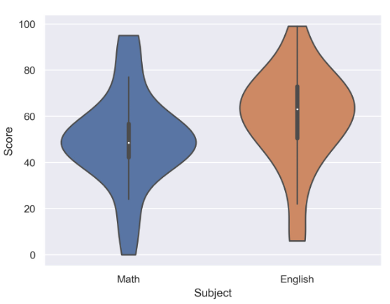
Introduction to Data Visualization Plots
CISC7204 Data Science and Data Visualization
Part 5: Distribution Plots
Violin Plot
Example
The diagram shows a violin plot for two variables and shows the performance of students in English and Math:
Violin plot for multiple variables (English and Math)
From the preceding diagram, we can say that on average, the students have scored more in English than in Math, but the highest score was secured in English.

Slide 75
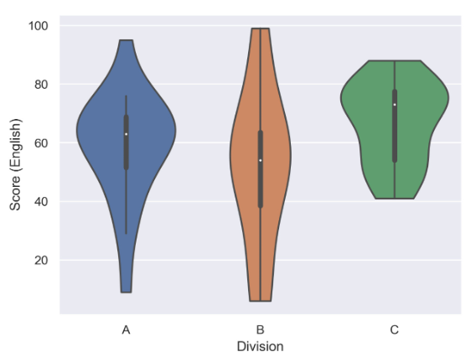
Introduction to Data Visualization Plots
CISC7204 Data Science and Data Visualization
Part 5: Distribution Plots
Violin Plot
Example
The diagram shows a violin plot for a single variable divided into three groups, and shows the performance of three divisions of students in English based on their score:
Violin plot with multiple categories (three groups of students)
From the preceding diagram, we can note that on average, division C has scored the highest, division B has scored the lowest, and division A is, on average, in between divisions B and C.

Slide 76
Introduction to Data Visualization Plots
CISC7204 Data Science and Data Visualization
Part 5: Distribution Plots
Violin Plot – Design Practice
Scale the axes accordingly so that the distribution is clearly visible and not flat.

Slide 77
Introduction to Data Visualization Plots
CISC7204 Data Science and Data Visualization
Part 6: Geoplots
Geological plots are a great way to visualize geospatial data.
Choropleth maps can be used to compare quantitative values for different countries, states, and so on.
If you want to show connections between different locations, connection maps are the way to go.

Slide 78
Introduction to Data Visualization Plots
CISC7204 Data Science and Data Visualization
Part 6: Geoplots
Dot Map
In a dot map, each dot represents a certain number of observations. Each dot has the same size and value (the number of observations each dot represents). The dots are not meant to be counted; they are only intended to give an impression of magnitude. The size and value are important factors for the effectiveness and impression of the visualization. You can use different colors or symbols for the dots to show multiple categories or groups.
Use
To visualize geospatial data.

Slide 79
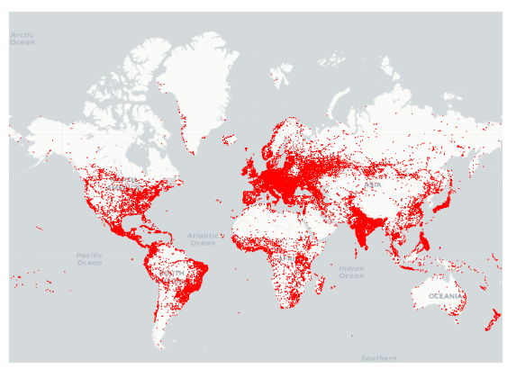
Introduction to Data Visualization Plots
CISC7204 Data Science and Data Visualization
Part 6: Geoplots
Dot Map
Example
The diagram shows a dot map where each dot represents a certain amount of bus stops throughout the world:
Dot map showing bus stops worldwide

Slide 80
Introduction to Data Visualization Plots
CISC7204 Data Science and Data Visualization
Part 6: Geoplots
Dot Map – Design Practices
Do not show too many locations. You should still be able to see the map to get a feel for the actual location.
Choose a dot size and value so that in dense areas, the dots start to blend. The dot map should give a good impression of the underlying spatial distribution.

Slide 81
Introduction to Data Visualization Plots
CISC7204 Data Science and Data Visualization
Part 6: Geoplots
Choropleth Map
In a choropleth map, each tile is colored to encode a variable. For example, a tile represents a geographic region for counties and countries. Choropleth maps provide a good way to show how a variable varies across a geographic area. One thing to keep in mind for choropleth maps is that the human eye naturally gives more attention to larger areas, so you might want to normalize your data by dividing the map area-wise.
Use
To visualize geospatial data grouped into geological regions—for example, states or countries.

Slide 82
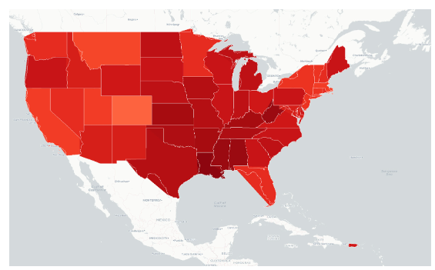
Introduction to Data Visualization Plots
CISC7204 Data Science and Data Visualization
Part 6: Geoplots
Choropleth Map
Example
The following diagram shows a choropleth map of a weather forecast in the USA:
Choropleth map showing a weather forecast for the USA

Slide 83
Introduction to Data Visualization Plots
CISC7204 Data Science and Data Visualization
Part 6: Geoplots
Choropleth Map – Design Practices
Use darker colors for higher values, as they are perceived as being higher in magnitude.
Limit the color gradation, since the human eye is limited in how many colors it can easily distinguish between. Seven color gradations should be enough.

Slide 84
Introduction to Data Visualization Plots
CISC7204 Data Science and Data Visualization
Part 6: Geoplots
Connection Map
In a connection map, each line represents a certain number of connections between two locations. The link between the locations can be drawn with a straight or rounded line, representing the shortest distance between them.
Each line has the same thickness and value (the number of connections each line represents). The lines are not meant to be counted; they are only intended to give an impression of magnitude. The size and value of a connection line are important factors for the effectiveness and impression of the visualization.
You can use different colors for the lines to show multiple categories or groups, or you can use a colormap to encode the length of the connection.
Use
To visualize connections.

Slide 85
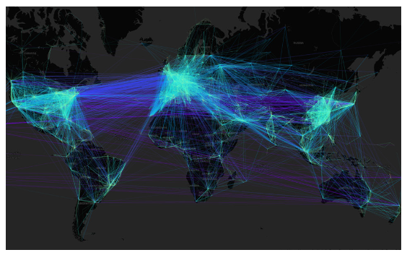
Introduction to Data Visualization Plots
CISC7204 Data Science and Data Visualization
Part 6: Geoplots
Connection Map
Example
The following diagram shows a connection map of flight connections around the world:
Connection map showing flight connections around the world

Slide 86
Introduction to Data Visualization Plots
CISC7204 Data Science and Data Visualization
Part 6: Geoplots
Connection Map – Design Practices
Do not show too many connections as it will be difficult for you to analyze the data. You should still see the map to get a feel for the actual locations of the start and end points.
Choose a line thickness and value so that the lines start to blend in dense areas. The connection map should give a good impression of the underlying spatial distribution.

Slide 87
Introduction to Data Visualization Plots
CISC7204 Data Science and Data Visualization
Part 6: Geoplots
Sum Up
Geoplots are special plots that are great for visualizing geospatial data. In the following section, we want to briefly talk about what’s generally important when it comes to creating good visualizations.

Slide 88
Introduction to Data Visualization Plots
CISC7204 Data Science and Data Visualization
Part 7: What Makes a Good Visualization?
There are multiple aspects to what makes a good visualization:
Most importantly, the visualization should be self-explanatory and visually appealing. To make it self-explanatory, use a legend, descriptive labels for your x-axis and y-axis, and titles.
A visualization should tell a story and be designed for your audience.
  Before creating your visualization, think about your target audience; create simple visualizations for a non-specialist audience and more technical detailed visualizations for a specialist audience.
  Think about a story to tell with your visualization so that your visualization leaves an impression on the audience.

Slide 89
Introduction to Data Visualization Plots
CISC7204 Data Science and Data Visualization
Part 7: What Makes a Good Visualization?
Common Design Practices
Use colors to differentiate variables/subjects rather than symbols, as colors are more perceptible.
To show additional variables on a 2D plot, use color, shape, and size.
Keep it simple and don’t overload the visualization with too much information.

Slide 90
Introduction to Data Visualization Plots
CISC7204 Data Science and Data Visualization
Part 8: Summary
This lecture covered the most important visualizations, categorized into comparison, relation, composition, distribution, and geological plots.
For each plot, a description, practical examples, and design practices were given.
Comparison plots, such as line charts, bar charts, and radar charts, are well suited to comparing multiple variables or variables over time.
Relation plots are perfectly suited to show relationships between variables. Scatter plots, bubble plots, which are an extension of scatter plots, correlograms, and heatmaps were considered.

Slide 91
Introduction to Data Visualization Plots
CISC7204 Data Science and Data Visualization
Part 8: Summary
Composition plots are ideal if you need to think about something as part of a whole. We first covered pie charts and continued with stacked bar charts, stacked area charts, and Venn diagrams.
For distribution plots that give a deep insight into how your data is distributed, histograms, density plots, box plots, and violin plots were considered.
Regarding geospatial data, we discussed dot maps, connection maps, and choropleth maps. Finally, some remarks were provided on what makes a good visualization.

Slide 92
Introduction to Data Visualization Plots
CISC7204 Data Science and Data Visualization
Part 8: Summary
In this Lecture 05, you have learned from:
Dobler, Mario & GroBmann, Tim (2020) The Data Visualization Workshop. Packt.

Slide 93
Introduction to Data Visualization Plots
CISC7204 Data Science and Data Visualization
THANK YOU!
Questions and Answers (Q & A)
Lecture 05 - 授人以魚不如授之以漁

